Slide 1
Process Planning in Machining

Slide 2
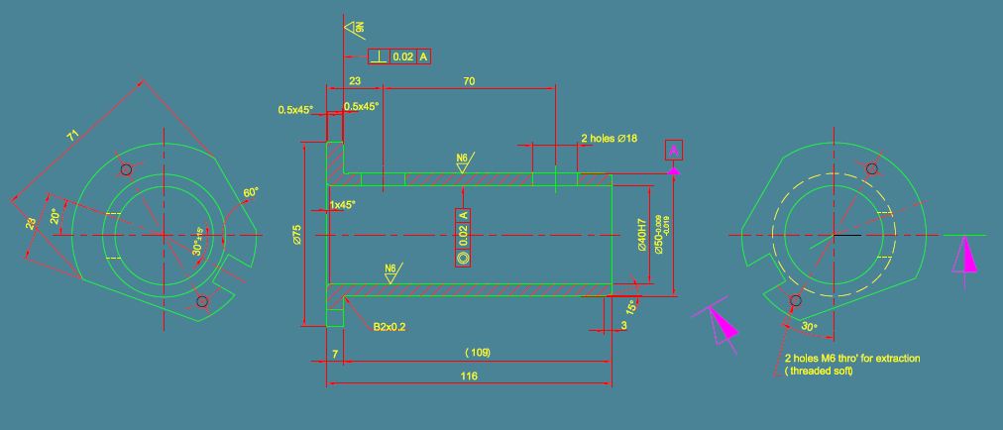
Component Name: Boring Tool Holder

Slide 3
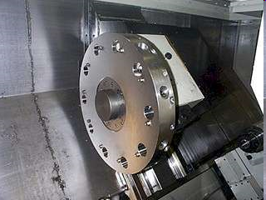
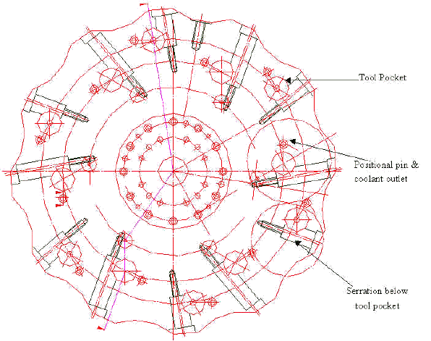
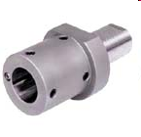
Sub-assembly: Turret
Turret: Drawing
Part: Tool holder

Slide 4
Process sheet/ Process layout: Detailed sequence of operations on different machines to make the part
Process planning: an engineering activity performed to prepare the process sheet.
Requirement: Knowledge of machining processes, machines, time estimation, toolings, work materials
Computerized process planning: Since each product and each company are different standard packages cannot do the job. Since the skill requirement is very high use of expert systems and/or artificial intelligence (AI) is required.
CAPP: 1) Retrieval type, 2) Generative type

Slide 5
Component Name: Boring Tool Holder

Slide 6
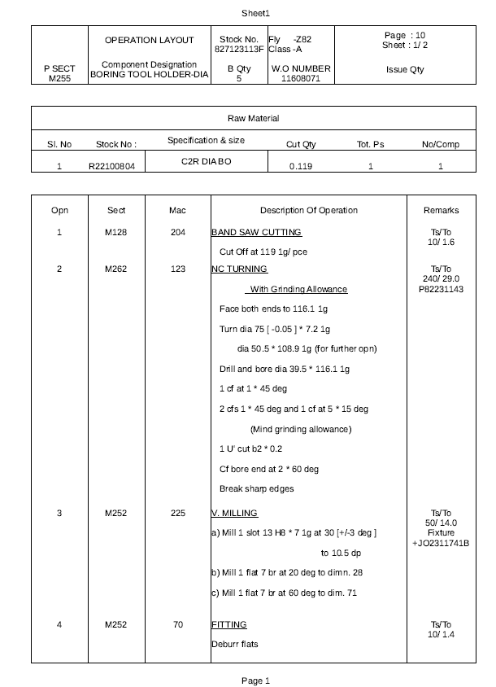
Sample process layout

Slide 7
Component Name: Boring Tool Holder

Slide 8
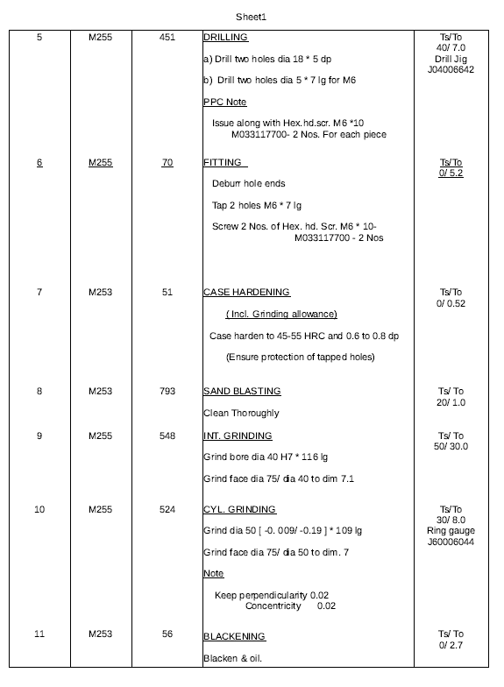
Sample process layout

Slide 9
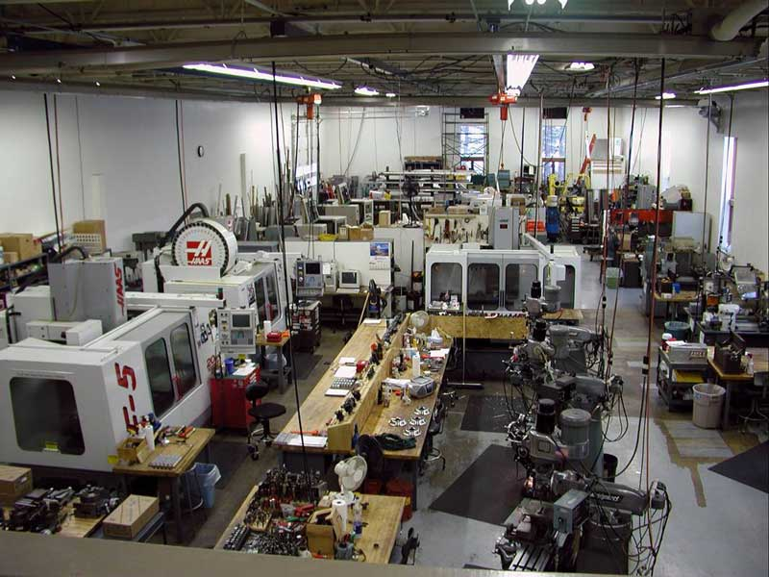
Machine shop- 1

Slide 10
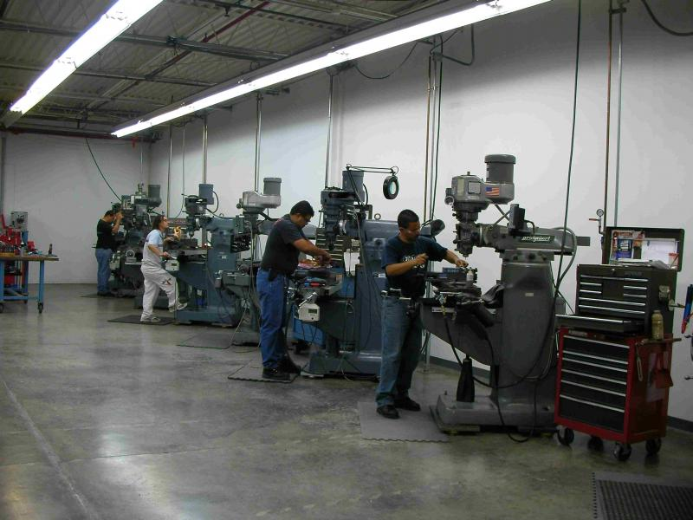
Machine shop- 2

Slide 11
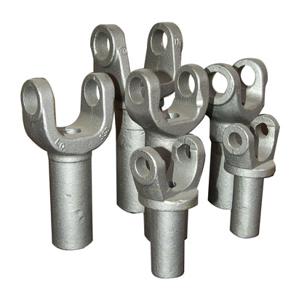
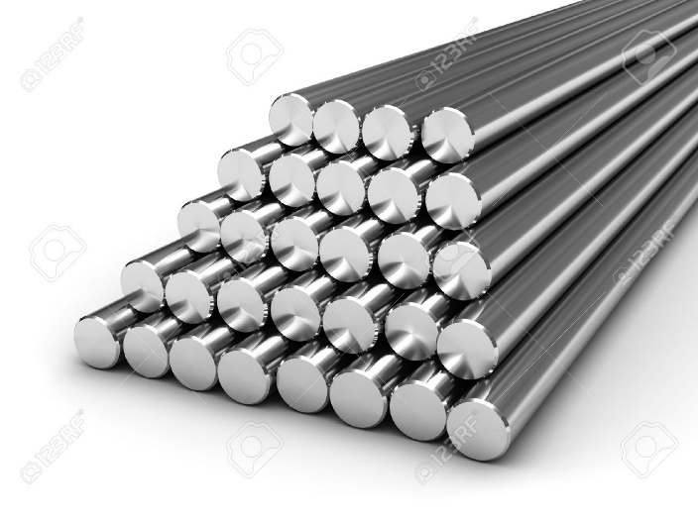
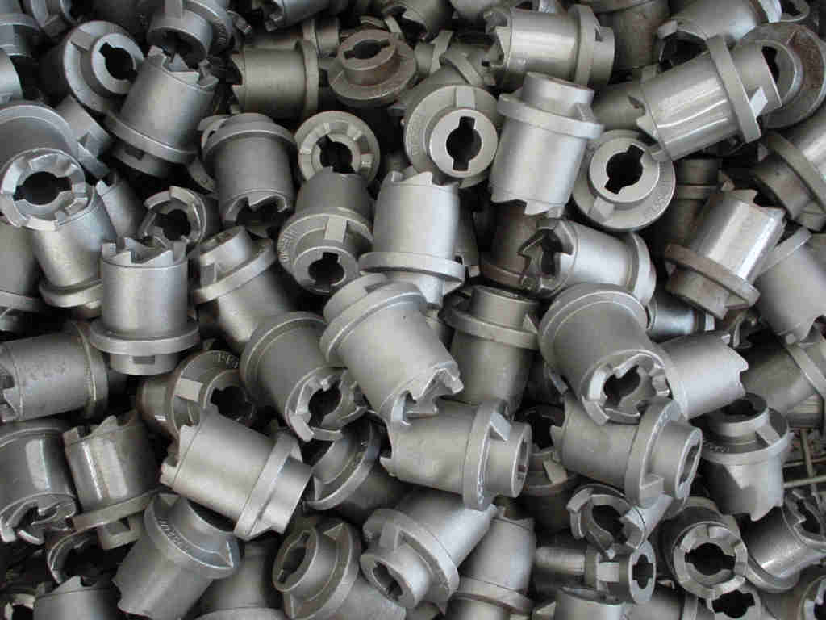
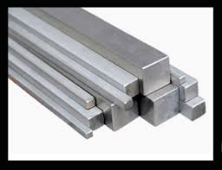
Raw Materials
Castings
Bar stock

Slide 12
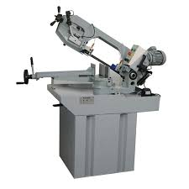
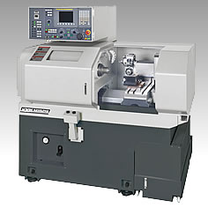
Band saw
NC- Turning

Slide 13
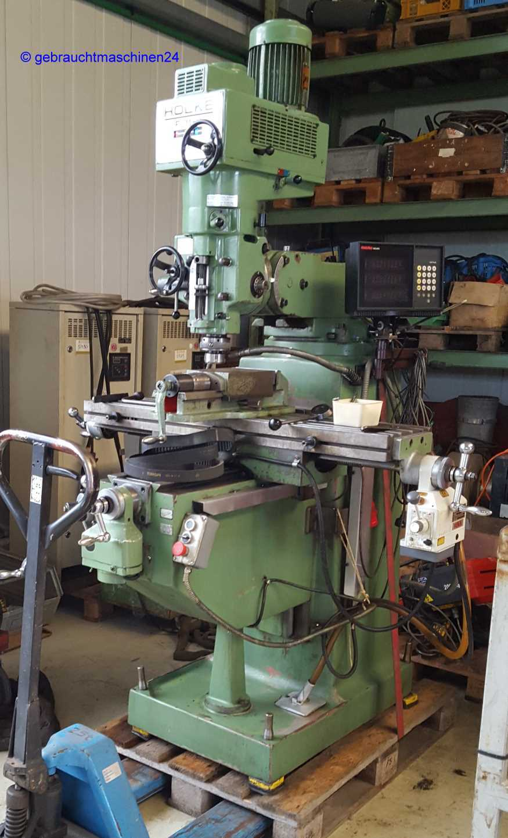
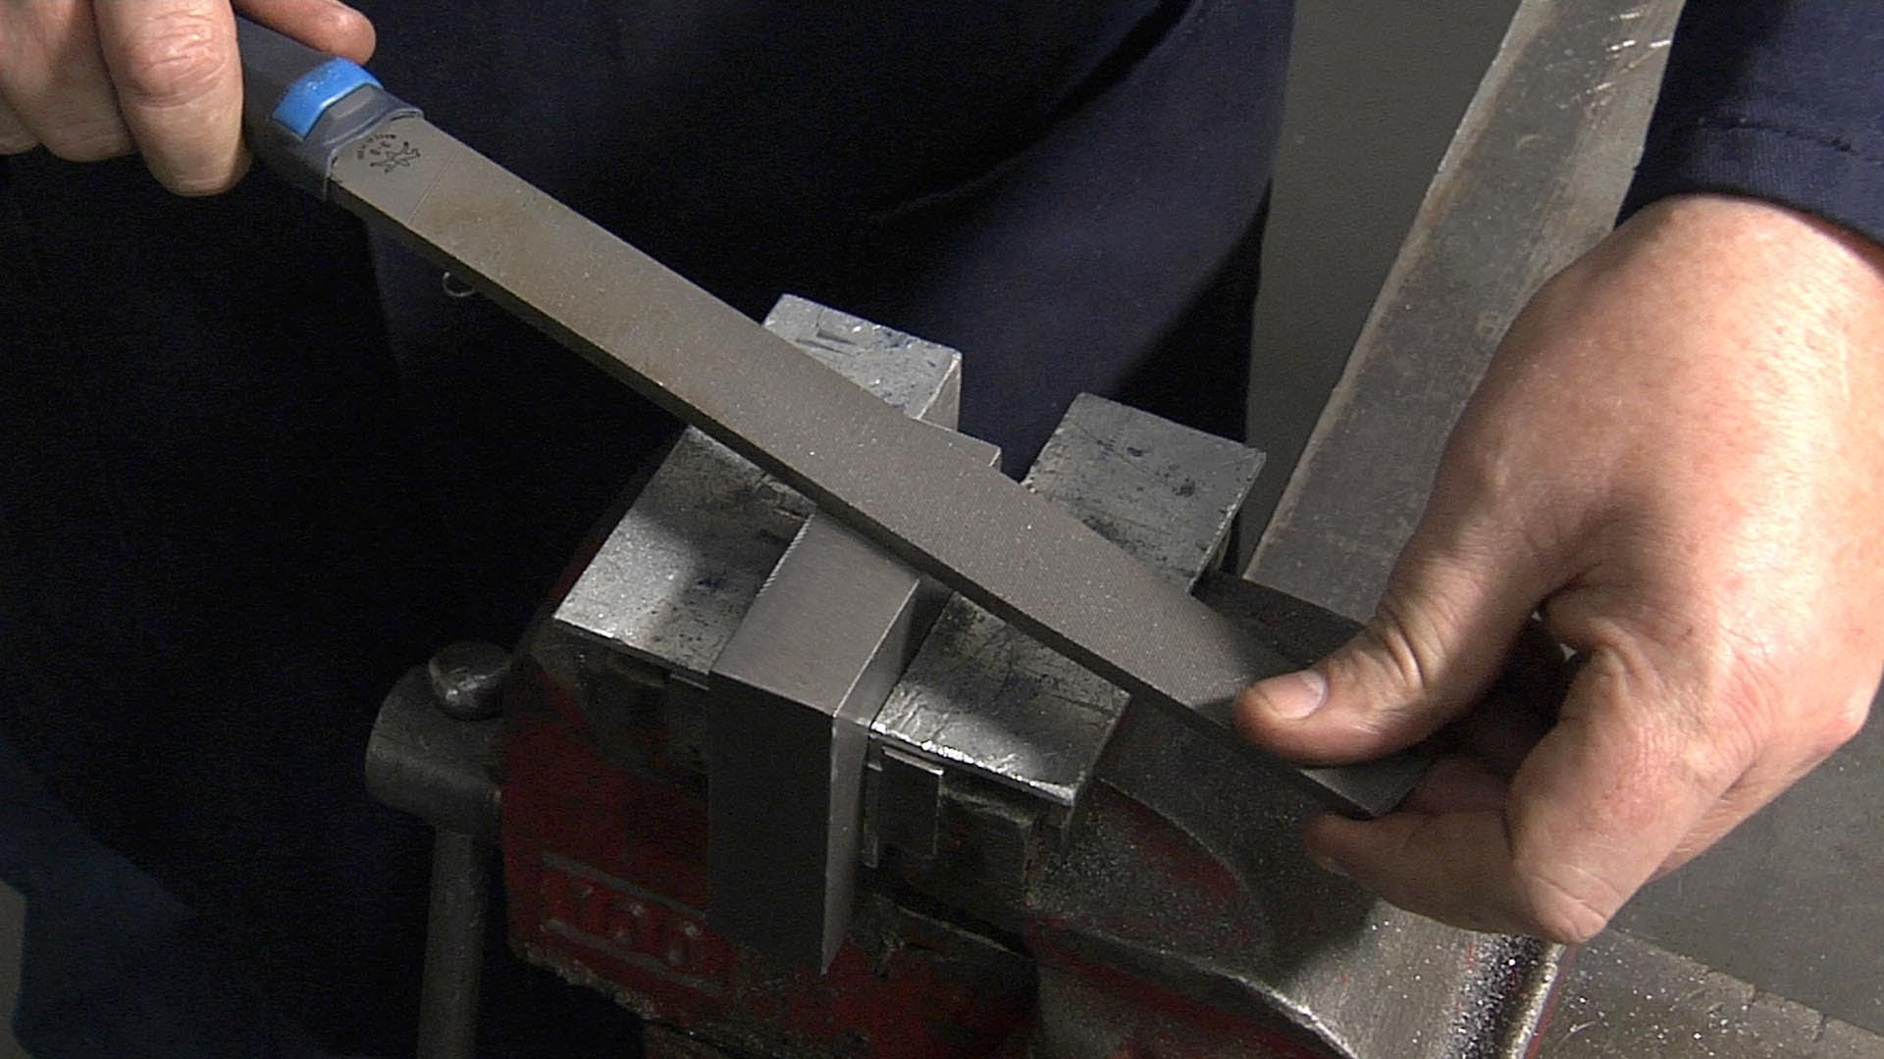
Vertical Milling
Fitting

Slide 14
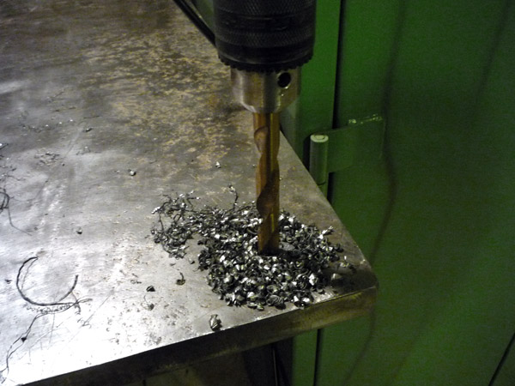
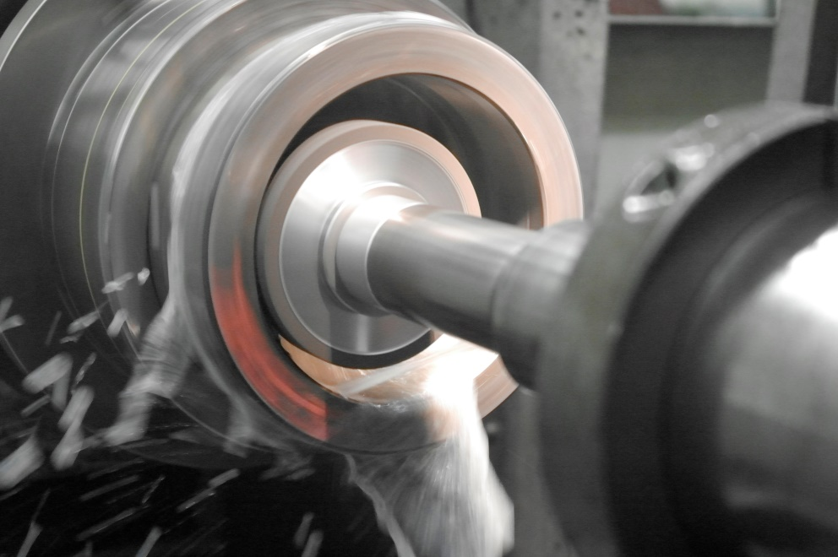
Drilling
Internal Grinding

Slide 15
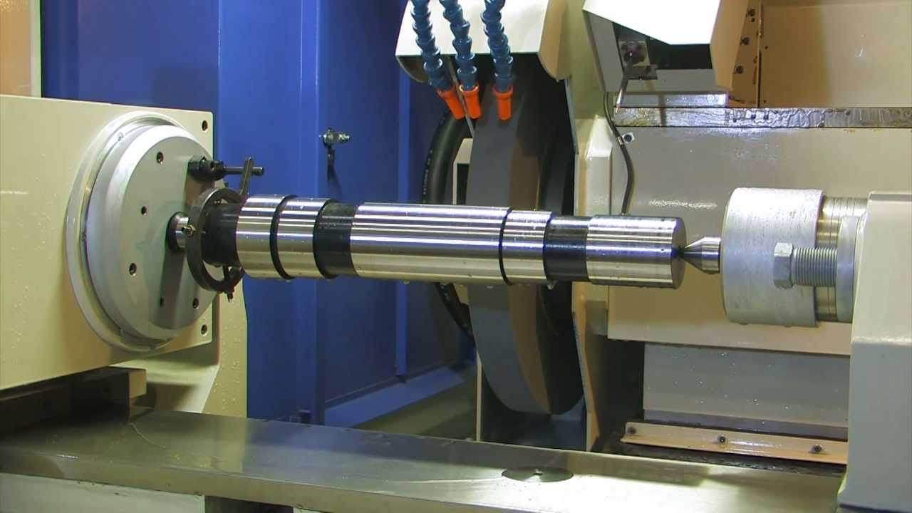
Cylindrical grinding

Slide 16
Process Planning Approaches
Manual Systems
Computer Aids
Variant System, retrieval system
Experimental Generative System

Slide 17
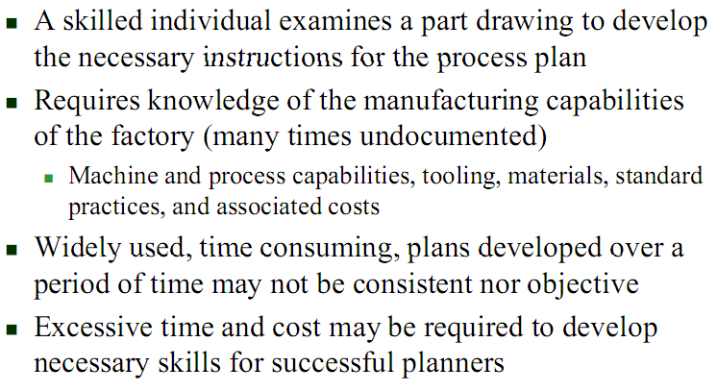
Manually Prepared Process Plans

Slide 18
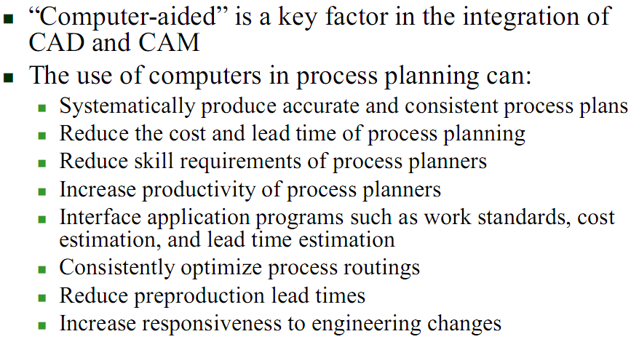
Computer Aids

Slide 19
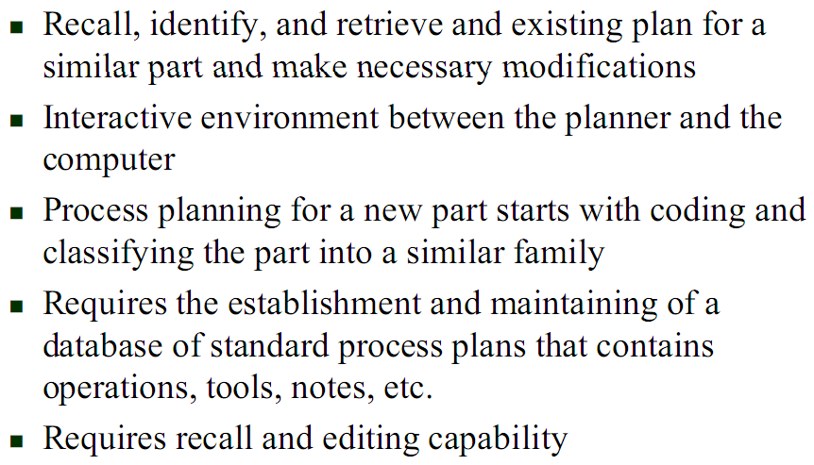
Variant (Retrieval) CAPP Methodology

Slide 20

Variant CAPP

Slide 21
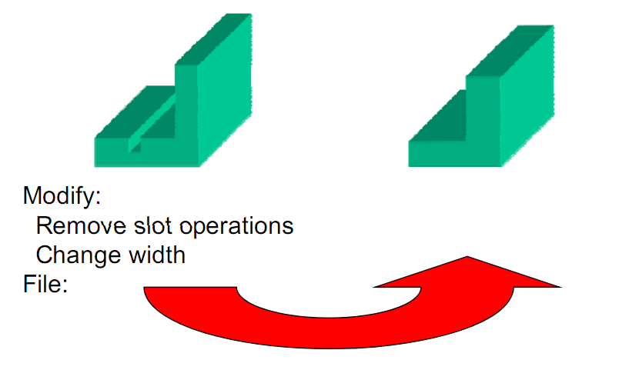
Variant CAPP

Slide 22
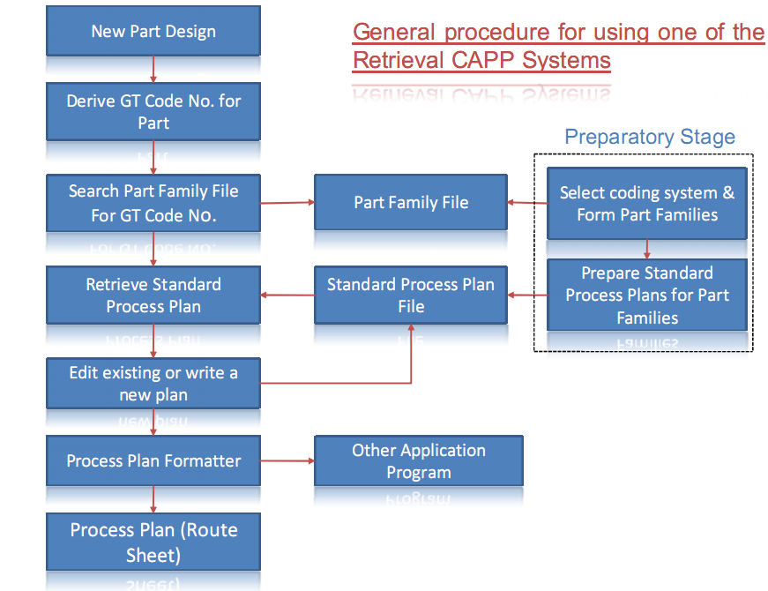

Slide 23
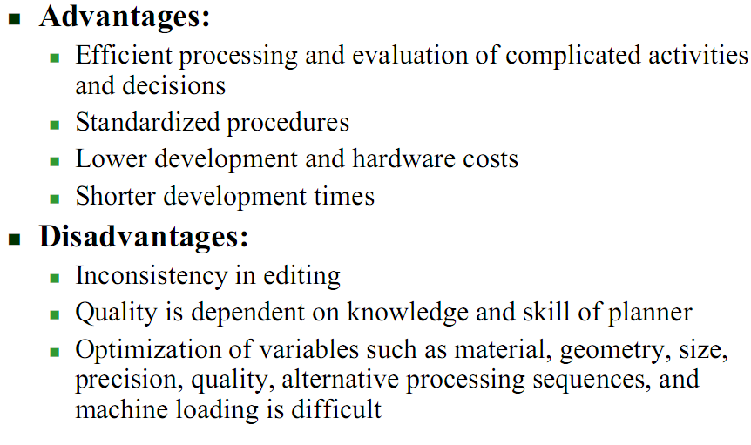
Variant CAPP

Slide 24
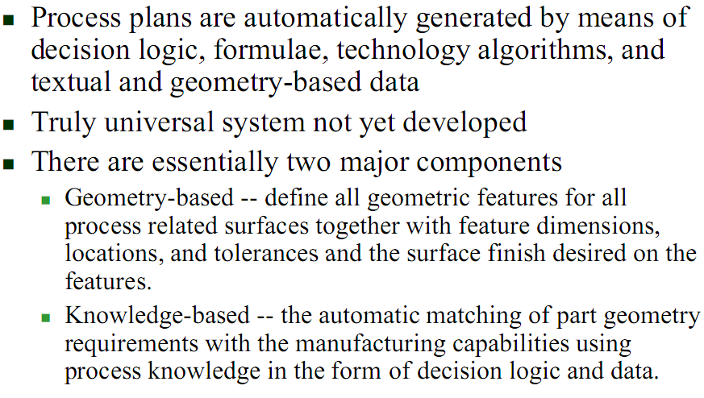
Generative CAPP Methodology

